Slide 1
Springboard Capstone Presentation
Titanic
Who survived the “unsinkable” ship?
by Stefani Clark

Slide 2
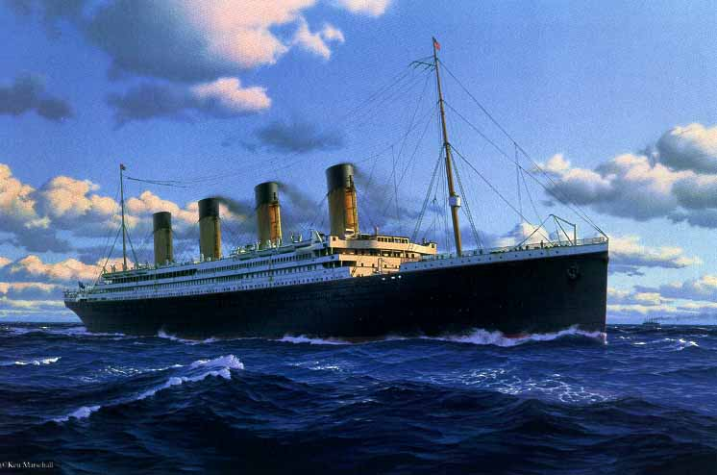
The Titanic The world’s first unsinkable ship took 3 years to build and less than 3 hours to sink. Who will Survive?

Slide 3

Post data analysis of the Titanic survivors has shown a significant correlation to class of ticket purchased and Survival!
Lets see what the models tells us ………………

Slide 4
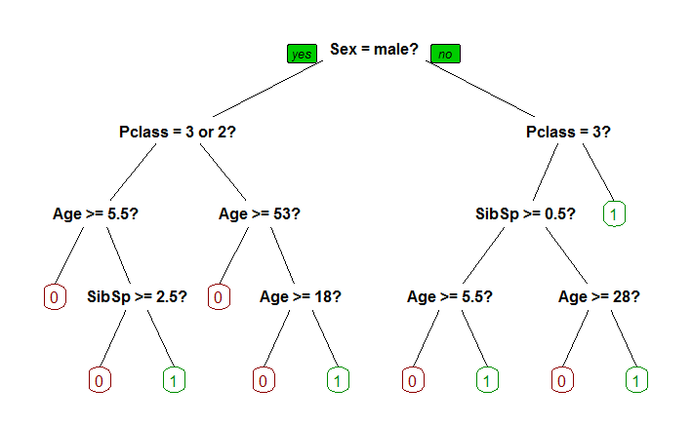
This is the Decision Tree model showing primary splits and highest correlation to survival are first gender, more females survived in all tree splits. * green “leaf”, terminal nodes are number ones (1 ) for Survived. The Confusion Matrix for the predictions show the following: Accuracy is 0.8127341 0 150 37 1 13 67 total true positives + total true negatives divided by the total = 217/267 = 0.8127341 Kaggle Score# 0.75598

Slide 5
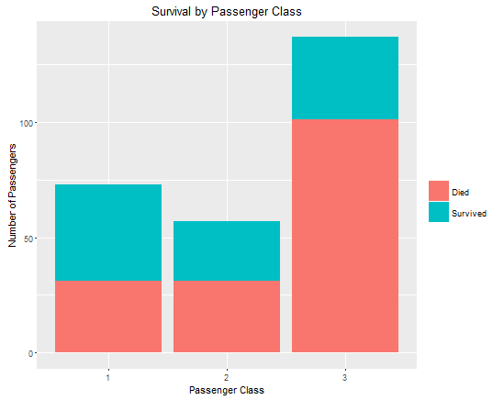
The GLM model showing a high correlation to survival based Passenger Class, First class having the highest number of survivors and Third class having the highest loss. GLM creates a response variable where the response variable is log odds log of odds, a value between 0 and 1 (where 1 is Survived). For GLM we created a threshold of 0.5 where we found we had the highest Accuracy score of 0.7894737 Accuracy using p>0.5 FALSE TRUE 0 101 21 1 23 64 101 + 64/209 = 0.7894737

Slide 6
Random Forest still working on this slide
Confusion matrix for Random Forest Results
Accuracy is 0.7865169
0 1 class.error
0 140 23 0.1411043
1 34 70 0.3269231

Slide 7
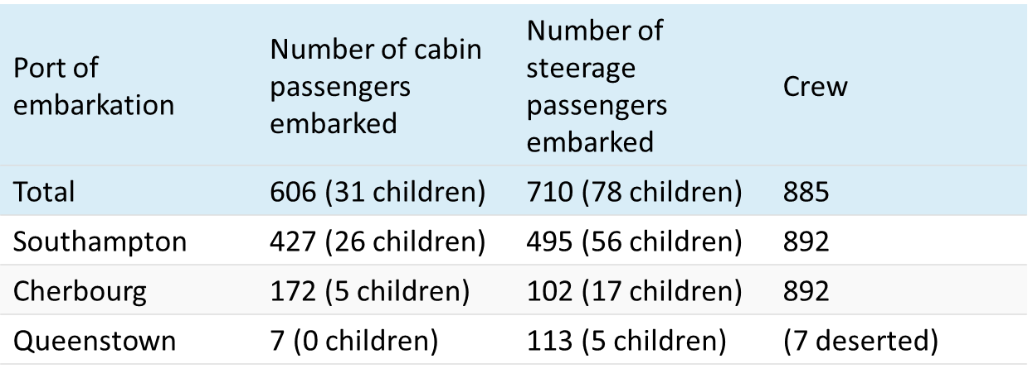
In closing…. As I embark on this fascinating world of Data Science. I would like to express my respect to the memories of those lives lost on the Titanic and acknowledge that no matter how much time passes our lives on earth are much more than the data we leave behind. ~stefani clark
List of those who perished http://www.encyclopedia-titanica.org/titanic-victims-list/
List of survivors http://www.encyclopedia-titanica.org/titanic-survivors/

